Slide 1


Prepared by Vincent & Sam

Slide 2

Transforming The Unwanted Into A Daily Need
Changing Overall Market Perception From INSURE To IMSURE (I’M SURE)
Super Insurance Mobile App/ Platform that comes with an ACQUISITION TOOL,
PRODUCTS CUSTOMIZATION ALGORITHM & REAL-TIME SERVICING MECHANISM

Slide 3
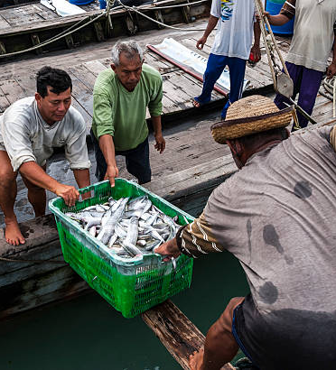

IMSURE IS CREATED FOR THESE TARGET SEGMENTS
The Under-reached & Under-served Rural, Hometown Market Segment
All the while neglected due to perceived high acquisition & servicing cost
More risk prone
Bigger family size (More dependants)
The pandemic has pushed this segment to adopt technology such as smart phones and social media
The Rising Gig and Evening & Night Economy Market Segment
Majority Gig Workers – Those who lost/quit their jobs & fresh graduates
Unstable Income
Will soon rise to be an ultimate contributor to the ‘Evening & Night-time Economy’

Slide 4
REAL-TIME DAILY RISK COVERAGE
Client swipe IMSURE Mobile App to purchase a coverage before starting the day
Commence on-spot daily Cognitive Risk Reasoning process
Algorithm Insurance Products offering with daily premium calculated
Purchase credit or top up to pay premium. Digital Contract done
Virtual Timer & Nudge System is activated. You are covered!
Client download IMSURE Mobile App & go through simple onboarding & guided products education process
I-Guardian Service -Client may swipe for instant assistant such as servicing, claims or any emergency assistant. I-Guardian will be on standby within 5km radius
Making Insurance Products Work Harder For You Everyday!

Slide 5
OUR ULTIMATE AIM
To encourage rural & hometown folks at least get a minimal insurance coverage
To reduce cost of sales agencies and branches management so such savings can be converted into offering cheaper insurance products or higher coverage
To increase country’s life insurance penetration rate from around 54% to at least 90%
Creating Gig Economy jobs by offering able individuals an opportuning to become I-Guardians providing on-demand insurance related services

